Slide 1

Computational Thinking
Benjamin Sabbione and Mike Olsen

Slide 2
Statement of the problem
We needed an insight into the historical performance of these companies to inform investment decisions (High/Low Prices)
We needed to identify patterns or trends in the trading volumes of these companies and how they have changed over the years (High/Low Volumes)
The purpose of extracting yearly open and close stock prices for Ferrari and Tesla allows the user to compare and contrast the performance of these companies over time (Yearly Open/Close Prices)

Slide 3
Overview of Data Sources
Kaggle Link
Share prices of Ferrari & Tesla from October 2015 – April 2023
Separate csv files containing similar columns:
Date, open, high, low, close, adjusted close, volume
13,202 total rows in each file

Slide 4
How the Data Sources were processed
Data was loaded from csv files using the pandas library
Date time was converted into datetime format
Filtered years between 2015-2023 and 2017-2021
Data that was extracted:
Highest and lowest values of each stock
Highest and lowest volumes of each stock
Open and Close values and Volumes of each tock
Stock price/volume was plotted using matplotlib

Slide 5
Detailed Plan of Solution and Approach Function #1
Load data from CSV files using pandas 'read_csv' function
Define the start and end year for the x – axis and set the years format for the x – axis labels using 'YearLocater' and 'DateFormatter' functions from 'matplotlib.dates' module
Created a new figure and axis object using 'subplots' function from 'matplotlib.pyplot'
Title, x-axis, y-axis labels: 'set_title', 'set_xlabel', and 'set_ylabel' functions
X-axis limits using 'set_xlim' function

Slide 6
Detailed PLAN OF SOLUTION AND APPROACH Function #2
Data will be filtered to include only the years 2015 – 2022
Calculate the highest/lowest volumes each year for both Ferrari and Tesla
Matplotlib to display volumes for each company over the years
X-axis (years), y-axis (volume),
Plot will include four lines: highest and lowest volumes for Ferrari, and highest and lowest volume for Tesla
Plot will have a title, axis labels, and legend

Slide 7
Detailed plan and approach for function #3
Extracting the opening and closing stock prices from 2014 – 2023
Provided by a CSV file
Groups the CSV file into the panda Data Frame, Groups the data by year
Aggregates the data to obtain the first opening and closing price of each year
Returns the two panda series objects containing the yearly opening and closing stock prices

Slide 8
Detailed Plan and approach for function #4
Responsible for creating a visual representation
Takes the file paths for the CSV files, as well as the start and end years, as input arguments
Created the function to create the yearly opening and closing stock prices when looking at both companies
Used a matplotlib library to create a line plot that displays the extracted data
Then the function configures the plot by adding labels, a title, and a legend after that it displays the plot using ply.Show()

Slide 9
Python Libraries in Solution Functions
Np.arange() - used to code 1D array of years from 2015 – 2022
Np.array() - used to code arrays for volume in each file, which were plotted over the years
Pandas (imported as pd) for data manipulation and analysis
Matplotlib.pyplot (imported as plt) for creating visualizations
Matplotlib.dates (imported as mdates) for formatting dates in the x-axis
Datetime (imported as dt) for working with dates and times
Numpy (imported as np) for mathematical functions

Slide 10
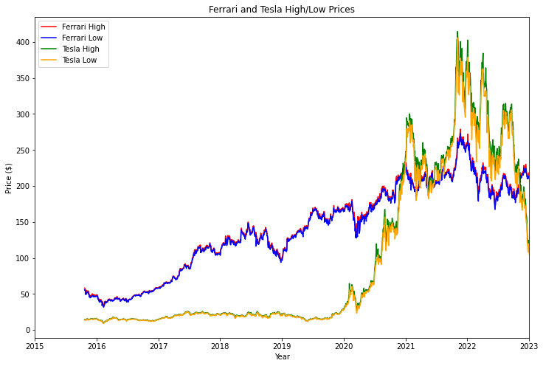
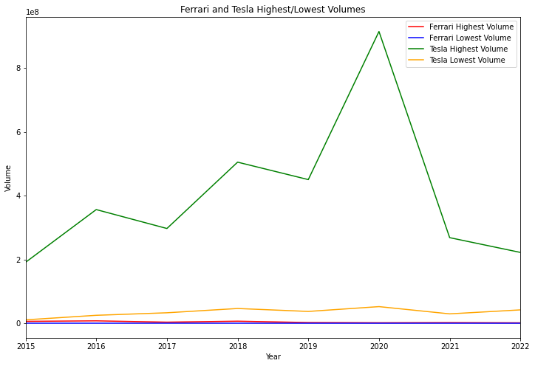
Output of function #1 and #2

Slide 11
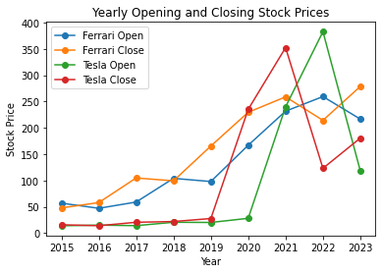
Output of Function #3 and #4

Slide 12
Takeaways and Conclusion
The script reads historical stock price data for Ferrari and Tesla from CSV files and extracts yearly opening and closing prices for a specified range of years (2015-2023).
By analyzing the plot, one can gain an insight into the stock performance of both companies and identify certain trends and changes in performance
The script also allows for a much more fluid and easy design to include more companies, time ranges, and any alternative data points which can provide necessary financial analysis and visualization

